Slide 1
House
Improvement Spending Prediction
By Old Iron Squad

Slide 2
Data Creation
Abbreviation | Description | Abbreviation | Description
Interest | interest rate | Oil | oil price
HPI | monthly house price | CPIHOSNS | consumer price index for all urban consumers
Unemployment | unemployment | Mortgage | 30-year fixed mortgage rate
Pop | Population (million) | Oak | oak price
RTFS | Retail Trade and Food Services | MSACSR | monthly supply of houses

Slide 3
Continued
Abbreviation | Description | Abbreviation | Description
Sales(target) | Sales in $MM | PSR | Personal saving rate
AR | Annual Rate for New Single-family Houses Sold | Steel | Price of steel bar
REALLN | Real Estate Loans of all Commercial Banks | Mortgage | 30-year fixed mortgage rate
sp_500 | S&P 500 index | median_income | Household median income
CCI | Consumer Confidence Index | NSFHUC | Price Indexes of New Single-Family Houses Under Construction

Slide 4
Continued
Abbreviation | Description | Abbreviation | Description
PLA | plastic material and resins manufacturing price | CCMS | CONVENTIONAL CONFORMING
NASDAQ | NASDAQ index | Steel | Price of steel bar
GDP | GDP by Billions (Quaterly) | CSUSHPINSA | S&P/Case-Shiller U.S. National Home Price Index
Sales(target) | Sales in $MM

Slide 5
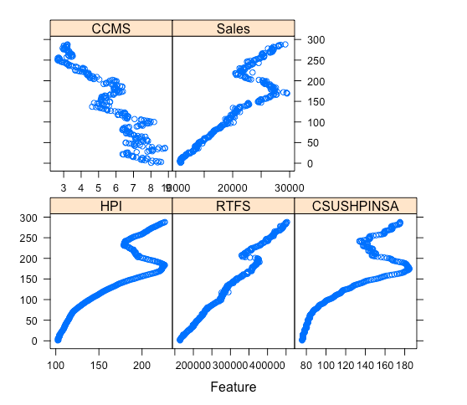
Scatter Plot (Variables v.s Date)
Looking at this graph, we can see that
RTFS
HPI
CSUSHPINSA
CCMS
have similar trends as Sales over time. So these might be the most important variables we want to fit in our model.
Place your screenshot here

Slide 6
Findings

Slide 7
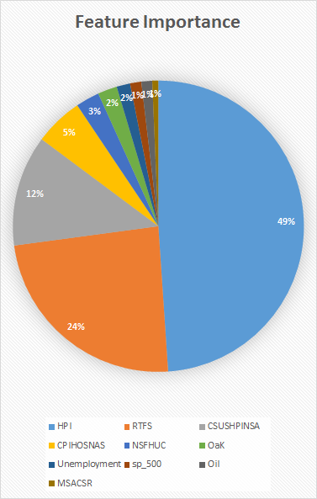
Features Importance & Results
After fitting all the variables in boosting model, we can get the variable importance, and this further confirms that we should use RTFS,HPI,CSUSHPINSA, and CCMS as our predictors.
Fitting those variables in Lasso model, the best RMSE we obtained in test set is 425.9.

Slide 8
Insights
In the final model, we only use “Retail Trade and Food Services”, “monthly house price ” , “S&P/Case-Shiller U.S. National Home Price Index”, “Conventional Conforming” to predict home improvement spending. It means that the home improvement spending is correlated with the real estate market. Specifically, people tends to spend more money on home improvement when the market is promising and vice versa.

Slide 9
Reference
All data sources are from https://fred.stlouisfed.org/

Slide 10
THANKS!

